Slide 1
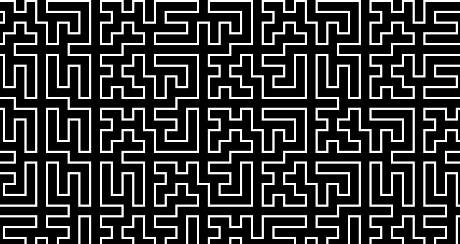
Enterprise java
Lecture 2 - Struts

Slide 2
Contents
Servlet Deployment
Servlet Filters
Model View Controllers
Struts
Dependency Injection

Slide 3
Application Deployment
Specifies how a web application is to be deployed in a Servlet container like Tomcat
ROOT/WEB-INF/web.xml
A mapping between a URL pattern and Servlet class
Normally auto generated by Eclipse for you – but can sometimes need some manual tweaking

Slide 4
Application Deployment – web.xml
<?xml version="1.0" encoding="UTF-8"?>
<web-app xmlns:xsi="http://www.w3.org/2001/XMLSchema-instance" xmlns="http://java.sun.com/xml/ns/javaee" xmlns:web="http://java.sun.com/xml/ns/javaee/web-app_2_5.xsd" xsi:schemaLocation="http://java.sun.com/xml/ns/javaee http://java.sun.com/xml/ns/javaee/web-app_2_5.xsd" id="WebApp_ID" version="2.5">
<display-name>Struts Example</display-name>
<servlet>
<description></description>
<display-name>Test</display-name>
<servlet-name>Test</servlet-name>
<servlet-class>Test</servlet-class>
</servlet>
<servlet-mapping>
<servlet-name>Test</servlet-name>
<url-pattern>/Test</url-pattern>
</servlet-mapping>
</web-app>
Servlet class definition
Servlet class-URL mapping

Slide 5
Servlet Filters - javax.servlet.Filter
Intercept and modify page requests and responses
Authentication
Logging
Compression
...
Used to wire up Struts and other frameworks
Simple class structure - doFilter(ServletRequest, ServletResponse, FilterChain)

Slide 6
Filters – web.xml
<filter>
<filter-name>struts2</filter-name>
<filter-class>
org.apache.struts2.dispatcher.FilterDispatcher
</filter-class>
</filter>
<filter-mapping>
<filter-name>struts2</filter-name>
<url-pattern>*.action</url-pattern>
</filter-mapping>

Slide 7
Model View Controller
Separate business logic, database, access, presentation, and control flow components
Model – classes used to store and manipulate state, typically in a database of some kind.
View – presentation layer / user interface used to render the model to the user
Controller – acts as a bridge between user input and the model and the view.

Slide 8
Struts
MVC Framework
Controller – is the Servlet based dispatch filter
Model – is the Action a Plain Old Java Object (POJO)
View – is the output JSP
Framework is wired up using XML and is bootstrapped via the dispatch filter in web.xml file
Framework uses dependency injection based on reflection to set properties on objects automatically

Slide 9
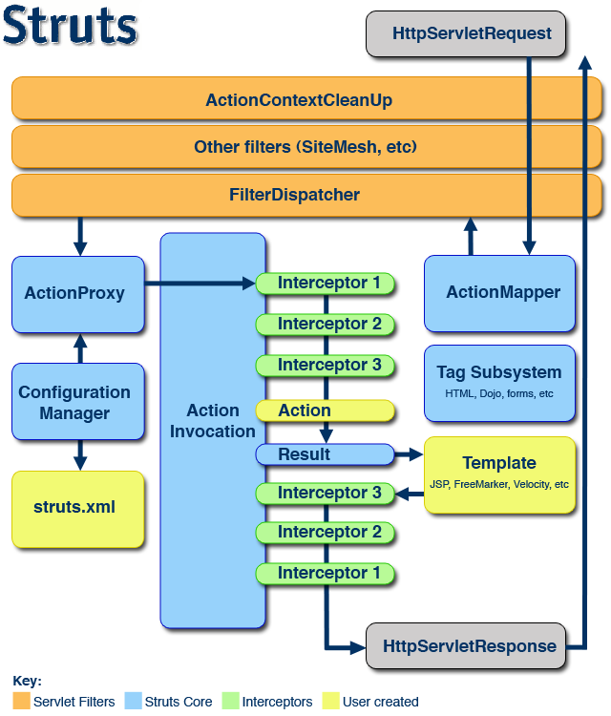
http://struts.apache.org/2.0.6/docs/big-picture.html

Slide 10
Action Class
The model class where all of the business logic takes place
A simple POJO that needs to comply with Struts framework conventions
Needs to have a public String execute() method which is the where the main body of code will go
Needs setters and getters to get access to the classes data items
Can create setters to get access to other resources like the HttpServletResponse object

Slide 11
Struts – Dependency Injection
Delegates responsibility for object creation and linking from the objects themselves to a factory
The object factories are managed internally by the Struts framework’s inversion of control container
Basically – a router that creates and links objects when required – based on parameter type and name of setter method
Factories for creating DataSource objects, Sockets etc.

Slide 12
Struts – Dependency Injection
Partially wired up with XML see struts.xml and automatically using inversion of control
public class SimpleQuery {
private String genre;
HttpServletResponse response;
public void setServletResponse(HttpServletResponse response) {
this.response = response;
}
public String execute(){
try {
PrintWriter out = response.getWriter();
}
catch (IOException e) {
// handle the exception ...
}
…

Slide 13
Struts - Configuration
<struts>
<constant name="struts.enable.DynamicMethodInvocation"
value="false" />
<constant name="struts.devMode" value="true" />
<package name="default" extends="struts-default" namespace="/">
<constant name="struts.custom.i18n.resources"
value="ApplicationResources" />
<action name="bookQuery" class="com.jcasey.BookQuery" method="query">
<result name="input" >query.jsp</result>
<result name="success" >query.jsp</result>
</action>
</package>
</struts>

Slide 14
Struts View Layer
Uses JSP can use other technologies as well like Velocity Macros, Free Maker etc.
Struts has its own tab library to define common HTML widgets
<%@ taglib prefix="s" uri="/struts-tags"%>
<s:form action="bookQuery" method="post">
<s:textfield name="title" key="label.title" size="20" /><s:fielderror fieldName="title" />
<s:textfield name="author" key="label.author" size="20" />
<s:textfield name="genre" key="label.genre" size="20" />
<s:submit method="execute" key="label.query" align="center" />
</s:form>
http://struts.apache.org/2.2.3/docs/using-struts-2-tags.html

Slide 15
Summary
Struts is plumbing, helps separate business logic from the presentation layer
Struts wires things up initially with XML, and does the rest with dependency injection
Looks complicated but is actually quite easy
Just one technology – plenty of other frameworks that do similar things
Be able to learn a new framework
Look at Apache Wicket, JBoss Seam etc.

